Slide 1

CSS
Lesson 13

Slide 2
CSS3 Introduction
CSS3 is split up into "modules". The old specification has been split into smaller pieces, and new ones are also added.
Box Model
Backgrounds and Borders
Text Effects
Multiple Column Layout
User Interface

Slide 3

CSS3 Backgrounds
CSS3 The background-origin Property
The background-origin property specifies the positioning area of the background images.
Internet Explorer 9+, Firefox, Chrome, Safari, and Opera support the new background properties.

Slide 4
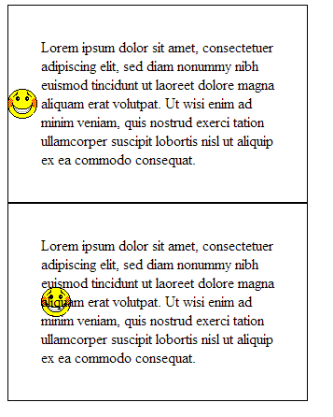
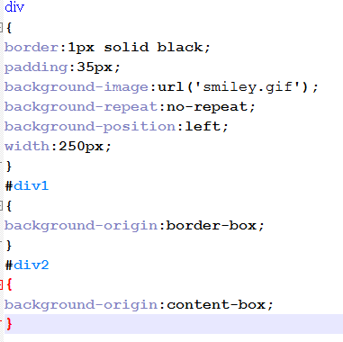
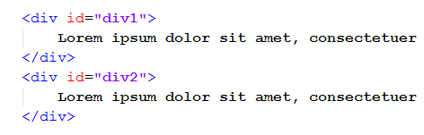
CSS3 Backgrounds
CSS3 The background-origin Property

Slide 5
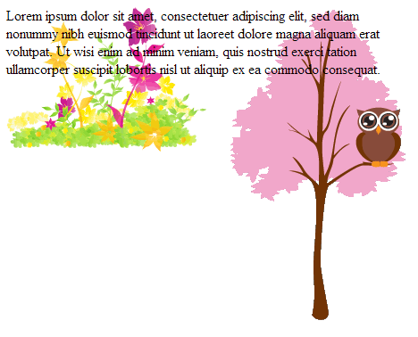
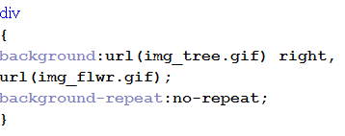
CSS3 Backgrounds
CSS3 Multiple Background Images
CSS3 allows you to use several background images for an element.

Slide 6

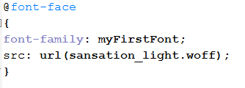
CSS3 Fonts
CSS3 @font-face Rule
Internet Explorer 9+, Firefox, Chrome, Safari, and Opera support the WOFF (Web Open Font Format) font.
Firefox, Chrome, Safari, and Opera support fonts of type TTF (True Type Fonts) and OTF (OpenType Fonts).
Chrome, Safari and Opera also support SVG fonts/shapes.
Internet Explorer also supports EOT (Embedded OpenType) fonts.

Slide 7
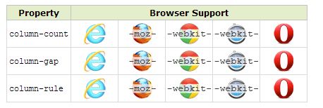
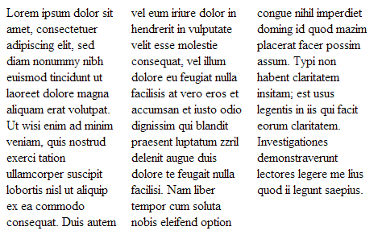
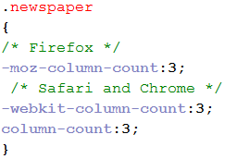
CSS3 multiple columns
The column-count property specifies the number of columns an element should be divided into:
CSS3 column-count

Slide 8
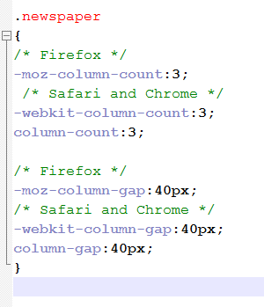
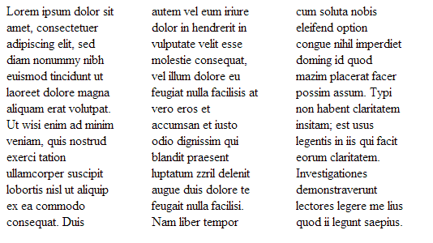
CSS3 multiple columns
CSS3 column-gap
The column-gap property specifies the gap between the columns.

Slide 9
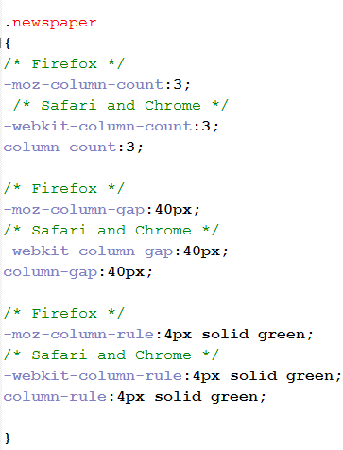
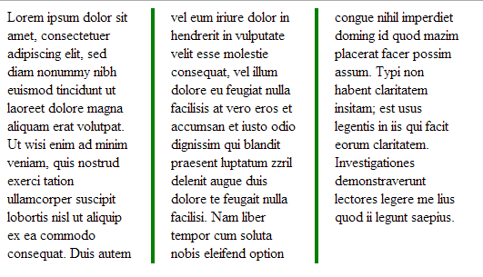
CSS3 multiple columns
CSS3 column-rule
The column-rule property sets the width, style, and color of the rule between columns.

Slide 10
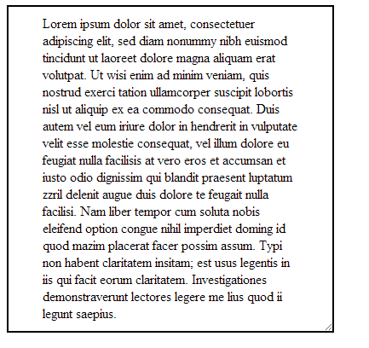
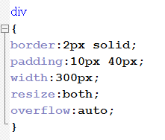
CSS3 user interface
CSS3 resize
In CSS3, the resize property specifies whether or not an element should be resizable by the user.

Slide 11

Task:1

Slide 12

Task:2

Slide 13
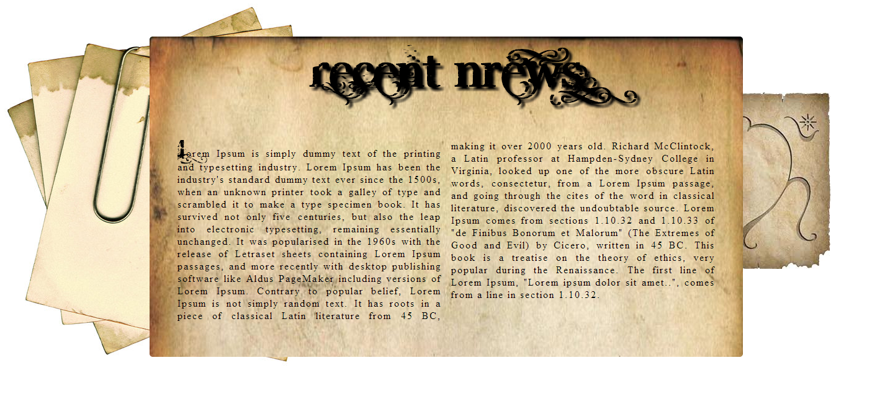
Task:3

